Slide 1
Assembler

Slide 2
Assembling
Assembler converts assembly into binary (eg. 32 bit)
1. Parse commando into fields assembly LOAD R3,7
2. For each field, generate bits
3. Replace symbols with addresses binary 110000101000000110000000000000111
4. Assemble binary codes into machine instructionsecture
CPU interacts with a memory device, receiving data from input device and sending data to output de
Symbols
Variables
Eg. variable that represents some weight, mapped on location 7 in the computer’s memory
LOAD R3,weight = LOAD R3,7
Labels
Eg. variable that represents some weight, mapped on location 7 in the computer’s memory
goto loop = goto 250

Slide 3
Assembling
Assembler converts assembly into binary (eg. 32 bit)
1. Parse commando into fields assembly LOAD R3,7
2. For each field, generate bits
3. Replace symbols with addresses binary 110000101000000110000000000000111
4. Assemble binary codes into machine instructionsecture
CPU interacts with a memory device, receiving data from input device and sending data to output de
Symbols
Variables
Eg. variable that represents some weight, mapped on location 7 in the computer’s memory
LOAD R3,weight = LOAD R3,7
Labels
Eg. variable that represents some weight, mapped on location 7 in the computer’s memory
goto loop = goto 250

Slide 4
Assembling
Assembler converts assembly into binary (eg. 32 bit)
1. Parse commando into fields assembly LOAD R3,7
2. For each field, generate bits
3. Replace symbols with addresses binary 110000101000000110000000000000111
4. Assemble binary codes into machine instructionsecture
CPU interacts with a memory device, receiving data from input device and sending data to output de
Symbols
Variables
Eg. variable that represents some weight, mapped on location 7 in the computer’s memory
LOAD R3,weight = LOAD R3,7
Labels
Eg. variable that represents some weight, mapped on location 7 in the computer’s memory
goto loop = goto 250

Slide 5
Assembling
Assembler converts assembly into binary (eg. 32 bit)
1. Parse commando into fields assembly LOAD R3,7
2. For each field, generate bits
3. Replace symbols with addresses binary 110000101000000110000000000000111
4. Assemble binary codes into machine instructionsecture
CPU interacts with a memory device, receiving data from input device and sending data to output de
Symbols
Variables
Eg. variable that represents some weight, mapped on location 7 in the computer’s memory
LOAD R3,weight = LOAD R3,7
Labels
Eg. variable that represents some weight, mapped on location 7 in the computer’s memory
goto loop = goto 250

Slide 6
Assembling
Assembler converts assembly into binary (eg. 32 bit)
1. Parse commando into fields assembly LOAD R3,7
2. For each field, generate bits
3. Replace symbols with addresses binary 110000101000000110000000000000111
4. Assemble binary codes into machine instructionsecture
CPU interacts with a memory device, receiving data from input device and sending data to output de
Symbols
Variables
Eg. variable that represents some weight, mapped on location 7 in the computer’s memory
LOAD R3,weight = LOAD R3,7
Labels
Eg. variable that represents some weight, mapped on location 7 in the computer’s memory
goto loop = goto 250

Slide 7
Assembling
Assembler converts assembly into binary (eg. 32 bit)
1. Parse commando into fields assembly LOAD R3,7
2. For each field, generate bits
3. Replace symbols with addresses binary 110000101000000110000000000000111
4. Assemble binary codes into machine instructionsecture
CPU interacts with a memory device, receiving data from input device and sending data to output de
Symbols
Variables
Eg. variable that represents some weight, mapped on location 7 in the computer’s memory
LOAD R3,weight = LOAD R3,7
Labels
Eg. variable that represents some weight, mapped on location 7 in the computer’s memory
goto loop = goto 250

Slide 8
Assembling
Assembler converts assembly into binary (eg. 32 bit)
1. Parse commando into fields assembly LOAD R3,7
2. For each field, generate bits
3. Replace symbols with addresses binary 11000010100000011000000000000011
4. Assemble binary codes into machine instructionsecture
CPU interacts with a memory device, receiving data from input device and sending data to output de
Symbols
Variables
Eg. variable that represents some weight, mapped on location 7 in the computer’s memory
LOAD R3,weight = LOAD R3,7
Labels
Eg. variable that represents some weight, mapped on location 7 in the computer’s memory
goto loop = goto 250

Slide 9
Assembling
Assembler converts assembly into binary (eg. 32 bit)
1. Parse commando into fields assembly LOAD R3,7
2. For each field, generate bits
3. Replace symbols with addresses binary 11000010100000011000000000000011
4. Assemble binary codes into machine instructionsecture
CPU interacts with a memory device, receiving data from input device and sending data to output de
Symbols
Variables
Eg. variable that represents some weight, mapped on location 7 in the computer’s memory
LOAD R3,weight = LOAD R3,7
Labels
Eg. variable that represents some weight, mapped on location 7 in the computer’s memory
goto loop = goto 250

Slide 10
Assembling
Assembler converts assembly into binary (eg. 32 bit)
1. Parse commando into fields assembly LOAD R3,7
2. For each field, generate bits
3. Replace symbols with addresses binary 11000010100000011000000000000011
4. Assemble binary codes into machine instructionsecture
CPU interacts with a memory device, receiving data from input device and sending data to output de
Symbols
Variables
Eg. variable that represents some weight, mapped on location 7 in the computer’s memory
LOAD R3,weight = LOAD R3,7
Labels
Eg. variable that represents some weight, mapped on location 7 in the computer’s memory
goto loop = goto 250

Slide 11
Assembling
Assembler converts assembly into binary (eg. 32 bit)
1. Parse commando into fields assembly LOAD R3,7
2. For each field, generate bits
3. Replace symbols with addresses binary 11000010100000011000000000000011
4. Assemble binary codes into machine instructionsecture
CPU interacts with a memory device, receiving data from input device and sending data to output de
Symbols
Variables
Eg. variable that represents some weight, mapped on location 7 in the computer’s memory
LOAD R3,weight = LOAD R3,7
Labels
Eg. variable that represents some weight, mapped on location 7 in the computer’s memory
goto loop = goto 250

Slide 12
Assembling
Assembler converts assembly into binary (eg. 32 bit)
1. Parse commando into fields assembly LOAD R3,7
2. For each field, generate bits
3. Replace symbols with addresses binary 11000010100000011000000000000011
4. Assemble binary codes into machine instructions
CPU interacts with a memory device, receiving data from input device and sending data to output de
Symbols
Variables
Eg. variable that represents some weight, mapped on location 7 in the computer’s memory
LOAD R3,weight = LOAD R3,7
Labels
Eg. variable that represents some weight, mapped on location 7 in the computer’s memory
goto loop = goto 250

Slide 13
Assembling
Assembler converts assembly into binary (eg. 32 bit)
1. Parse commando into fields assembly LOAD R3,7
2. For each field, generate bits
3. Replace symbols with addresses binary 11000010100000011000000000000011
4. Assemble binary codes into machine instructionsecture
CPU interacts with a memory device, receiving data from input device and sending data to output de
Symbols
Variables
Eg. variable that represents some weight, mapped on location 7 in the computer’s memory
LOAD R3,weight = LOAD R3,7
Labels
Eg. variable that represents some weight, mapped on location 7 in the computer’s memory
goto loop = goto 250

Slide 14
Assembling
Assembler converts assembly into binary (eg. 32 bit)
1. Parse commando into fields assembly LOAD R3,7
2. For each field, generate bits
3. Replace symbols with addresses binary 11000010100000011000000000000011
4. Assemble binary codes into machine instructionsecture
CPU interacts with a memory device, receiving data from input device and sending data to output de
Symbols
Variables
Eg. variable that represents some weight, mapped on location 7 in the computer’s memory
LOAD R3,weight = LOAD R3,7
Labels
Eg. variable that represents some weight, mapped on location 7 in the computer’s memory
goto loop = goto 250

Slide 15
Assembling
Assembler converts assembly into binary (eg. 32 bit)
1. Parse commando into fields assembly LOAD R3,7
2. For each field, generate bits
3. Replace symbols with addresses binary 11000010100000011000000000000011
4. Assemble binary codes into machine instructionsecture
CPU interacts with a memory device, receiving data from input device and sending data to output de
Symbols
Variables
Eg. variable that represents some weight, mapped on location 7 in the computer’s memory
LOAD R3,weight = LOAD R3,7
Labels
Eg. variable that represents some weight, mapped on location 7 in the computer’s memory
goto loop = goto 250

Slide 16
Assembling
Assembler converts assembly into binary (eg. 32 bit)
1. Parse commando into fields assembly LOAD R3,7
2. For each field, generate bits
3. Replace symbols with addresses binary 11000010100000011000000000000011
4. Assemble binary codes into machine instructionsecture
CPU interacts with a memory device, receiving data from input device and sending data to output de
Symbols
Variables
Eg. variable that represents some weight, mapped on location 7 in the computer’s memory
LOAD R3,weight = LOAD R3,7
Labels
Eg. variable that represents some weight, mapped on location 7 in the computer’s memory
goto loop = goto 250

Slide 17
Assembling
Assembler converts assembly into binary (eg. 32 bit)
1. Parse commando into fields assembly LOAD R3,7
2. For each field, generate bits
3. Replace symbols with addresses binary 11000010100000011000000000000011
4. Assemble binary codes into machine instructionsecture
CPU interacts with a memory device, receiving data from input device and sending data to output de
Symbols
Variables
Eg. variable that represents some weight, mapped on location 7 in the computer’s memory
LOAD R3,weight = LOAD R3,7
Labels
Eg. variable that represents some weight, mapped on location 7 in the computer’s memory
goto loop = goto 250

Slide 18
Assembling
Assembler converts assembly into binary (eg. 32 bit)
1. Parse commando into fields assembly LOAD R3,7
2. For each field, generate bits
3. Replace symbols with addresses binary 11000010100000011000000000000011
4. Assemble binary codes into machine instructionsecture
CPU interacts with a memory device, receiving data from input device and sending data to output de
Symbols
Variables
Eg. variable that represents some weight, mapped on location 7 in the computer’s memory
LOAD R3,weight = LOAD R3,7
Labels
Eg. variable that represents some weight, mapped on location 7 in the computer’s memory
goto loop = goto 250

Slide 19
Assembling
Assembler converts assembly into binary (eg. 32 bit)
1. Parse commando into fields assembly LOAD R3,7
2. For each field, generate bits
3. Replace symbols with addresses binary 11000010100000011000000000000011
4. Assemble binary codes into machine instructionsecture
CPU interacts with a memory device, receiving data from input device and sending data to output de
Symbols
Variables
Eg. variable that represents some weight, mapped on location 7 in the computer’s memory
LOAD R3,weight = LOAD R3,7
Labels
Eg. variable that represents some weight, mapped on location 7 in the computer’s memory
goto loop = goto 250

Slide 20
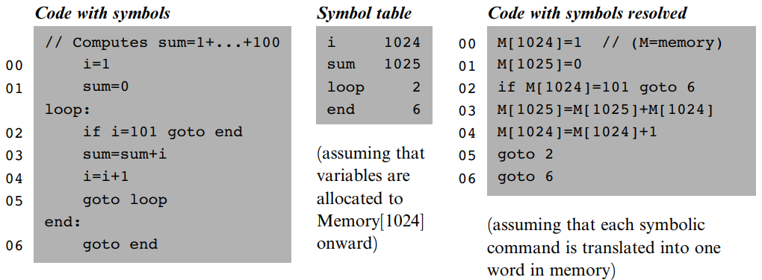
Symbol resolution
Sample program with 4 symbols
2 variables: i and sum
2 labels: loop and end
2 rules for symbol table
Translated code will be stored starting at address 0
Variables will be allocated starting at address 1024
Resolved program
Comments and labels ignored
Infinite loop “terminates” program

Slide 21
Symbol resolution
Sample program with 4 symbols
2 variables: i and sum
2 labels: loop and end
2 rules for symbol table
Translated code will be stored starting at address 0
Variables will be allocated starting at address 1024
Resolved program
Comments and labels ignored
Infinite loop “terminates” program

Slide 22
Symbol resolution
Sample program with 4 symbols
2 variables: i and sum
2 labels: loop and end
2 rules for symbol table
Translated code will be stored starting at address 0
Variables will be allocated starting at address 1024
Resolved program
Comments and labels ignored
Infinite loop “terminates” program

Slide 23
Symbol resolution
Sample program with 4 symbols
2 variables: i and sum
2 labels: loop and end
2 rules for symbol table
Translated code will be stored starting at address 0
Variables will be allocated starting at address 1024
Resolved program
Comments and labels ignored
Infinite loop “terminates” program

Slide 24
Symbol resolution
Sample program with 4 symbols
2 variables: i and sum
2 labels: loop and end
2 rules for symbol table
Translated code will be stored starting at address 0
Variables will be allocated starting at address 1024
Resolved program
Comments and labels ignored
Infinite loop “terminates” program

Slide 25
Symbol resolution
Sample program with 4 symbols
2 variables: i and sum
2 labels: loop and end
2 rules for symbol table
Translated code will be stored starting at address 0
Variables will be allocated starting at address 1024
Resolved program
Comments and labels ignored
Infinite loop “terminates” program

Slide 26
Symbol resolution
Sample program with 4 symbols
2 variables: i and sum
2 labels: loop and end
2 rules for symbol table
Translated code will be stored starting at address 0
Variables will be allocated starting at address 1024
Resolved program
Comments and labels ignored
Infinite loop “terminates” program

Slide 27
Symbol resolution
Sample program with 4 symbols
2 variables: i and sum
2 labels: loop and end
2 rules for symbol table
Translated code will be stored starting at address 0
Variables will be allocated starting at address 1024
Resolved program
Comments and labels ignored
Infinite loop “terminates” program

Slide 28
Symbol resolution
Sample program with 4 symbols
2 variables: i and sum
2 labels: loop and end
2 rules for symbol table
Translated code will be stored starting at address 0
Variables will be allocated starting at address 1024
Resolved program
Comments and labels ignored
Infinite loop “terminates” program

Slide 29
Symbol resolution
Sample program with 4 symbols
2 variables: i and sum
2 labels: loop and end
2 rules for symbol table
Translated code will be stored starting at address 0
Variables will be allocated starting at address 1024
Resolved program
Comments and labels ignored
Infinite loop “terminates” program

Slide 30
Symbol resolution
Sample program with 4 symbols
2 variables: i and sum
2 labels: loop and end
2 rules for symbol table
Translated code will be stored starting at address 0
Variables will be allocated starting at address 1024
Resolved program
Comments and labels ignored
Infinite loop “terminates” program

Slide 31
Symbol resolution
Sample program with 4 symbols
2 variables: i and sum
2 labels: loop and end
2 rules for symbol table
Translated code will be stored starting at address 0
Variables will be allocated starting at address 1024
Resolved program
Comments and labels ignored
Infinite loop “terminates” program

Slide 32
Symbol resolution
Sample program with 4 symbols
2 variables: i and sum
2 labels: loop and end
2 rules for symbol table
Translated code will be stored starting at address 0
Variables will be allocated starting at address 1024
Resolved program
Comments and labels ignored
Infinite loop “terminates” program

Slide 33
Symbol resolution
Sample program with 4 symbols
2 variables: i and sum
2 labels: loop and end
2 rules for symbol table
Translated code will be stored starting at address 0
Variables will be allocated starting at address 1024
Resolved program
Comments and labels ignored
Infinite loop “terminates” program

Slide 34
Recap assembly
Prog.asm (assembly) assembled into Prog.hack (binary) behaves completely differently each time it is loaded with a different program
Assembly: each line is either an instruction (A or C) or a symbol declaration
Binary: line n stored in address n of instruction memory
CPU interacts with a memory device, receiving data fr
Assembly conventions
Constants: non-negative and decimal
Symbols: any sequence of letters, digits (not beginning), and special characters ( _ , . , $ , : )
Comments: text beginning with // and ending at the end of the line is ignored
White space: space characters and empty lines are ignored
Case
All assembly mnemonics in uppercase
The rest (user-defined labels and variables) are case sensitive (typically uppercase labels and lowercase variables) m input device and sending data to output device

Slide 35
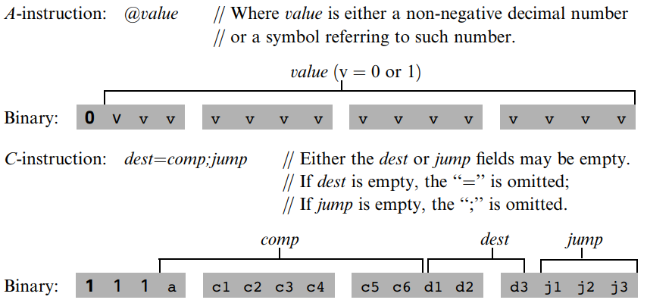
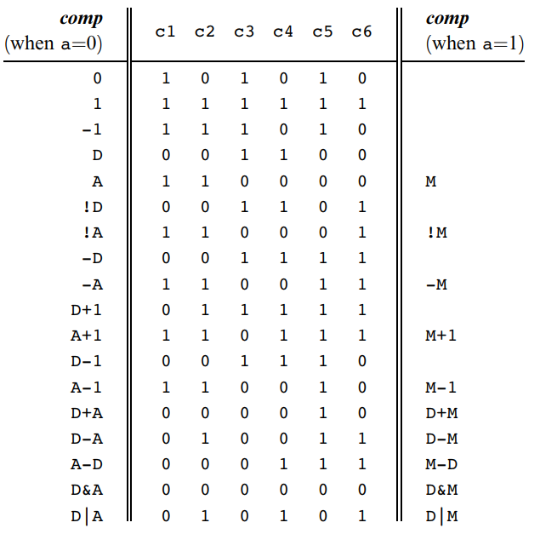
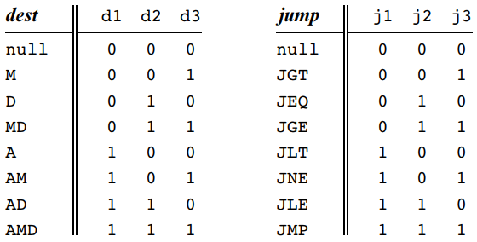
Recap instructions
A-instruction
C-instruction

Slide 36
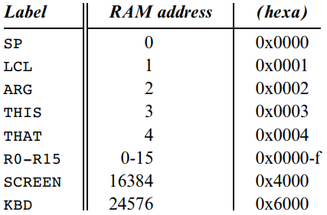
Recap symbols
Pre-defined symbols
Eg. SP = R0, LCL = R1, etc…
Label symbols: (Xxx) refers to the next command
Variable symbols: symbol not defined using (Xxx), stored starting address 16 (0x0010)

Slide 37
Implementation
Input file supplied to assembler as command line argument
prompt> Assembler Prog.asm
Assembler design recommended in 2 steps and by modules
1. Symbol-less phase
a) Parser: parses the input
b) Converter: provides the binary codes of all the assembly mnemonics
2. Symbol version
a) SymbolTable: handles symbols
All within one main program: drives the entire translation process

Slide 38
Implementation
Input file supplied to assembler as command line argument
prompt> Assembler Prog.asm
Assembler design recommended in 2 steps and by modules
1. Symbol-less phase
a) Parser: parses the input
b) Converter: provides the binary codes of all the assembly mnemonics
2. Symbol version
a) SymbolTable: handles symbols
All within one main program: drives the entire translation process

Slide 39
Implementation
Input file supplied to assembler as command line argument
prompt> Assembler Prog.asm
Assembler design recommended in 2 steps and by modules
1. Symbol-less phase
a) Parser: parses the input
b) Converter: provides the binary codes of all the assembly mnemonics
2. Symbol version
a) SymbolTable: handles symbols
All within one main program: drives the entire translation process

Slide 40
Implementation
Input file supplied to assembler as command line argument
prompt> Assembler Prog.asm
Assembler design recommended in 2 steps and by modules
1. Symbol-less phase
a) Parser: parses the input
b) Converter: provides the binary codes of all the assembly mnemonics
2. Symbol version
a) SymbolTable: handles symbols
All within one main program: drives the entire translation process

Slide 41
Implementation
Input file supplied to assembler as command line argument
prompt> Assembler Prog.asm
Assembler design recommended in 2 steps and by modules
1. Symbol-less phase
a) Parser: parses the input
b) Converter: provides the binary codes of all the assembly mnemonics
2. Symbol version
a) SymbolTable: handles symbols
All within one main program: drives the entire translation process

Slide 42
Implementation
Input file supplied to assembler as command line argument
prompt> Assembler Prog.asm
Assembler design recommended in 2 steps and by modules
1. Symbol-less phase
a) Parser: parses the input
b) Converter: provides the binary codes of all the assembly mnemonics
2. Symbol version
a) SymbolTable: handles symbols
All within one main program: drives the entire translation process

Slide 43
Implementation
Input file supplied to assembler as command line argument
prompt> Assembler Prog.asm
Assembler design recommended in 2 steps and by modules
1. Symbol-less phase
a) Parser: parses the input
b) Converter: provides the binary codes of all the assembly mnemonics
2. Symbol version
a) SymbolTable: handles symbols
All within one main program: drives the entire translation process

Slide 44
Implementation
Input file supplied to assembler as command line argument
prompt> Assembler Prog.asm
Assembler design recommended in 2 steps and by modules
1. Symbol-less phase
a) Parser: parses the input
b) Converter: provides the binary codes of all the assembly mnemonics
2. Symbol version
a) SymbolTable: handles symbols
All within one main program: drives the entire translation process

Slide 45
Implementation symbol-less
Parser
Encapsulates access to input
Breaks each assembly command into its underlying fields and symbols
Removes white space and comments
Code
Asssuming no symbols, convert A-instruction values and C-instruction fields

Slide 46
Implementation symbol-less
Parser
Encapsulates access to input
Breaks each assembly command into its underlying fields and symbols
Removes white space and comments
Code
Asssuming no symbols, convert A-instruction values and C-instruction fields

Slide 47
Implementation symbol-less
Parser
Encapsulates access to input
Breaks each assembly command into its underlying fields and symbols
Removes white space and comments
Code
Asssuming no symbols, convert A-instruction values and C-instruction fields

Slide 48
Implementation symbol-less
Parser
Encapsulates access to input
Breaks each assembly command into its underlying fields and symbols
Removes white space and comments
Code
Asssuming no symbols, convert A-instruction values and C-instruction fields

Slide 49
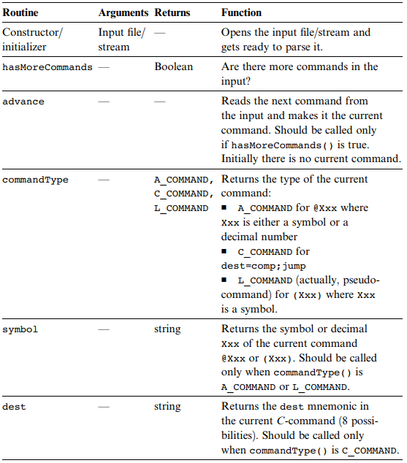
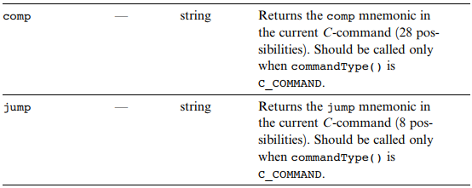
Implementation symbol-less
Parser
Encapsulates access to input
Breaks each assembly command into its underlying fields and symbols
Removes white space and comments
Code
Asssuming no symbols, convert A-instruction values and C-instruction fields

Slide 50
Implementation symbol-less
Parser
Encapsulates access to input
Breaks each assembly command into its underlying fields and symbols
Removes white space and comments
Code
Asssuming no symbols, convert A-instruction values and C-instruction fields

Slide 51
Implementation symbol-less
Parser
Encapsulates access to input
Breaks each assembly command into its underlying fields and symbols
Removes white space and comments
Code
Asssuming no symbols, convert A-instruction values and C-instruction fields

Slide 52
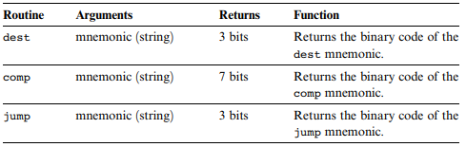
Implementation symbol-less
Parser
Encapsulates access to input
Breaks each assembly command into its underlying fields and symbols
Removes white space and comments
Code
Asssuming no symbols, convert A-instruction values and C-instruction fields

Slide 53
Implementation with symbols
Initialize table (eg. use a hash table)
Hard-code predefine commands along with their addresses
Do two passes
First pass: labels (Xxx)
Keep running count of instruction numbers (ROM addresses
Starts at 0 and is incremented by 1 whenever an A- or C-instruction is encountered, but not for labels
If (Xxx) label encountered, add entry to the symbol table, associating Xxx with the next command in the program
Second pass: user-defined symbols @example
Then run symbol-less version

Slide 54
Implementation testing
Try to assemble sample programs
Check correctness with the supplied assembler
Use your assembler’s output as the compare file

Slide 55
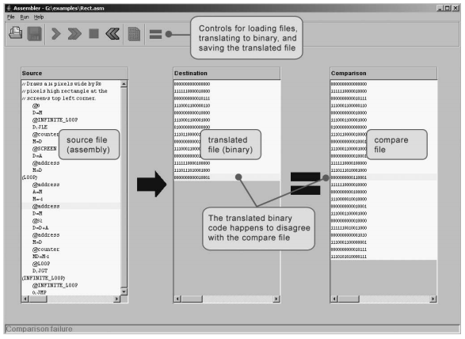
Implementation testing
Try to assemble sample programs
Check correctness with the supplied assembler
Use your assembler’s output as the compare file

Slide 56
Perspective
Assembler = relatively simple text processor
You can code it to convert eg. D=M[xxx] into @xxx followed by D=M
Most assembly written by machines, not humans
Stand-alone assemblers are rare, typically compilers don’t care about symbols and will directly convert high-level code to binary
Many high-level compilers allow embedding segments of assembly code within the high-level program for optimization

Slide 57
Perspective
Assembler = relatively simple text processor
You can code it to convert eg. D=M[xxx] into @xxx followed by D=M
Most assembly written by machines, not humans
Stand-alone assemblers are rare, typically compilers don’t care about symbols and will directly convert high-level code to binary
Many high-level compilers allow embedding segments of assembly code within the high-level program for optimization

Slide 58
Perspective
Assembler = relatively simple text processor
You can code it to convert eg. D=M[xxx] into @xxx followed by D=M
Most assembly written by machines, not humans
Stand-alone assemblers are rare, typically compilers don’t care about symbols and will directly convert high-level code to binary
Many high-level compilers allow embedding segments of assembly code within the high-level program for optimization

Slide 59
Perspective
Assembler = relatively simple text processor
You can code it to convert eg. D=M[xxx] into @xxx followed by D=M
Most assembly written by machines, not humans
Stand-alone assemblers are rare, typically compilers don’t care about symbols and will directly convert high-level code to binary
Many high-level compilers allow embedding segments of assembly code within the high-level program for optimization

Slide 60
Perspective
Assembler = relatively simple text processor
You can code it to convert eg. D=M[xxx] into @xxx followed by D=M
Most assembly written by machines, not humans
Stand-alone assemblers are rare, typically compilers don’t care about symbols and will directly convert high-level code to binary
Many high-level compilers allow embedding segments of assembly code within the high-level program for optimization

